Slide 1
Notes:
Queries inside a query

Slide 3
Notes:
Where to use them and the tools available for each

Slide 4
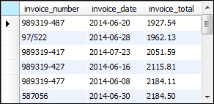
Notes:
The subquery is in the WHERE clause
Where invoice total > this subquery which is another select statement
Selecting the average of an invoice total from invoices = becomes a number
In English, it’s picking out of rows, want to know which rows represent the data that are above the average using invoice_total column
It’s in ascending format unless you specify specifically
Doing this kind of thing makes it more flexible
Select statement inside another select statement
Parens is the subquery
Filtering out more (giving more control)

Slide 5
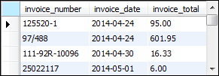
Notes:
This is what you’d use without subqueries

Slide 6
Notes:
The WHERE here is a search condition (remember)
Select the vendor_ids from vendors table where it’s CA (so use the vendor_ids that are from CA and report this information)
Easier to understand relationship kind of in reading
Might be better when the datasets are large for performance
Usually has to do with WHERE

Slide 7
Notes:
Existing relationship – table that has a foreign key to another table
Aggregate values – SUM and tuff

Slide 8
Notes:
Select vendor_ids that are not in the distinct vendor_ids in invoices

Slide 9
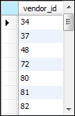
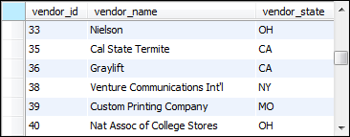
Notes:
Maybe run subqueries serperately

Slide 10
Notes:
IS NULL = NOT IN

Slide 11
Notes:
WHERE clause is used as a comparison
The three operators are SOME, ANY, and ALL
> 0 AND less than this part (signifies a range)
Where it’s going to be < the average of these columns from the invoice table that are > 0
Cannot use balance_due aliases (just column names, not true referrable aliases/variables)
The range is between 0 and 2910 (average)

Slide 12
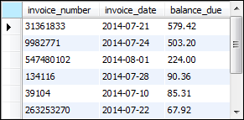

Slide 13
Notes:
The upper end vs lower end
1 and 2 are the starting point so use arrows to point at thing
Remember <> is the equivalent of the not
So anything outside 1 and 2 will be included in part of the last statement

Slide 14

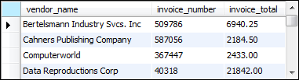
Notes:
ALL of a selected range
Let’s start with the subquery
Wanted to select the invoice_total from the invoices table where the vendor_id = 34
So we’re filtering out the subset
The first invoice_total refers to all the columns
Performing a join, so you can see that the subquery has 2-3 rows
Notice that all the invoice_totals in the result are > 1083
Okay, so we’re doing a join (we’re using columns from both tables) matching up vendor_ids
The subquery’s results are the invoice_totals that have 34 as the vendor_id
And so it’s doing ALL(e, f)
Since it’s > ALL, it’s x > f
The upper limit would be the biggest number since it’s greater (if there’s 3 numbers)
It’s automatically ASCENDING format

Slide 15
Notes:
It’s the lower limit (similar, but the range is different)
It uses lower end for > and oppoite
The = x in between 1 and 2
<> is x NOT IN 1 or x NOT IN 2 (discrete math)

Slide 16
Notes:
6 is the lower limit and the other number is the upper (25.67)
If it’s less than, then it’s < 25.67
Notice all invoice_totals meet this requirement

Slide 17
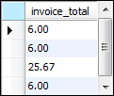
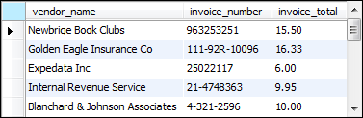

Slide 18
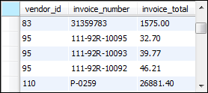
Notes:
I need to find the vendor_ids that are larger than 28.50

Slide 19
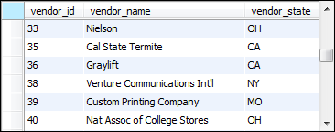
Notes:
WHERE EXISTS and NOT EXISTS = a subset inside a set, and then whatever is outside that subset is the NOT
The subquery:
Select all columns from invoices that have a vendor id in the vendors table
(AKA select all vendors WITH invoices, because if it exists, it has an id)

Slide 20
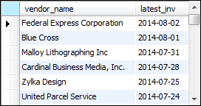
Notes:
Manipulating the selection part as the subquery
Just selecting the maximum of the invoice date (most recent)
The MAX for each vendor_id (since there are multiple invoice dates for distinct vendor_ids?)

Slide 22
Notes:
Inside FROM (inline view = separate subset in a table format)
SUM of invoice_total as sum_of_invoices
From v join I where the vendor_ids match
Vendor state first, then vendor name (grouped first and second)
Now followed by group by vendor_state, further grouping by vendor_tate
Group by is like “find the # of customers in each country” = where the group is the country

Slide 23
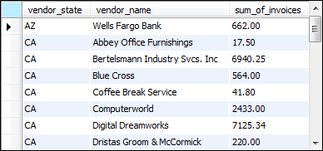

Notes:
Notice the CA value in the result set is the MAX of all the CA entries
So group by is like a summary row (remember it’s used with aggregate functions, where MAX ha been used above), the MAX is what we’re looking at
The FROM is the selection criteria (another table) and then further filter

Slide 24
Notes:
t1 is the alias to the generated result of the subquery in this case
T1 creates another table and need to give it a name to refer to it
Remember, all FROMs refer to a table, so the subquery here needs to be given a name
Now that table exists in the memory of the computer where the DBMS runs from

Slide 26
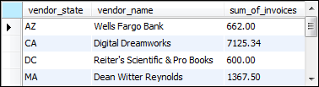

Slide 27
Notes:
It’s just the result of multiple parts joined together
Don’t want to create a table just to use another or smthg, just want to make it all into one
If t1 and t2 and t3 are large (10 mil), the complex query will take some time, then might do something more permanent rather than this way? How often you use it and how large the dataset
Think it’s at the moment

Slide 29


Slide 30


